Slide 1
BIA674_Exhibit3_EDA
File created on: 4/16/25 4:11:30 PM EDT

Slide 2
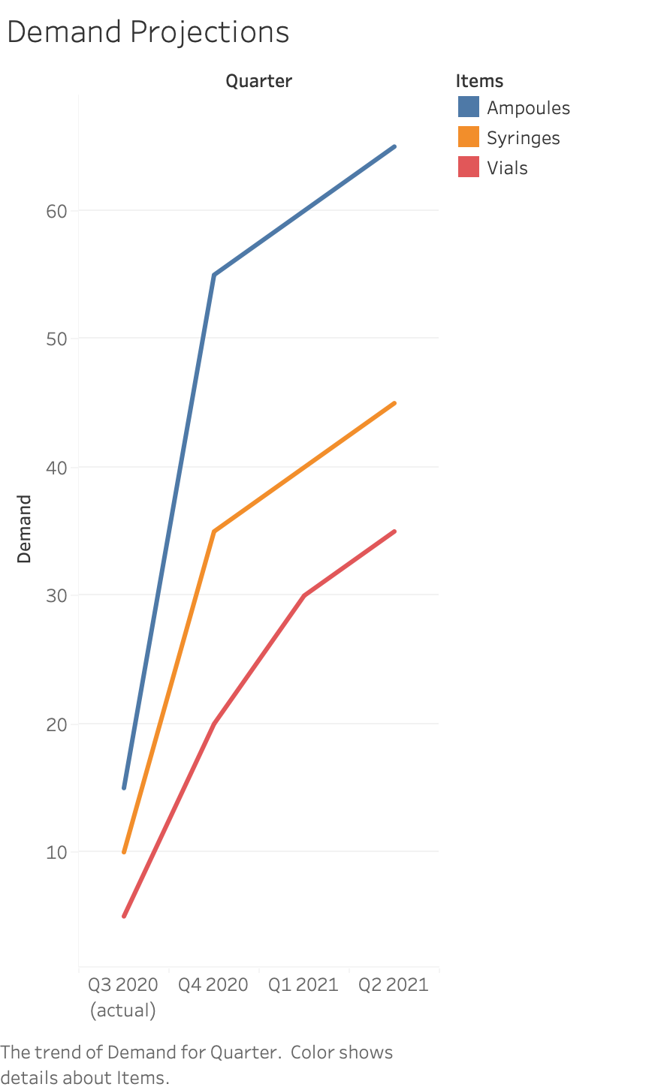

Slide 3
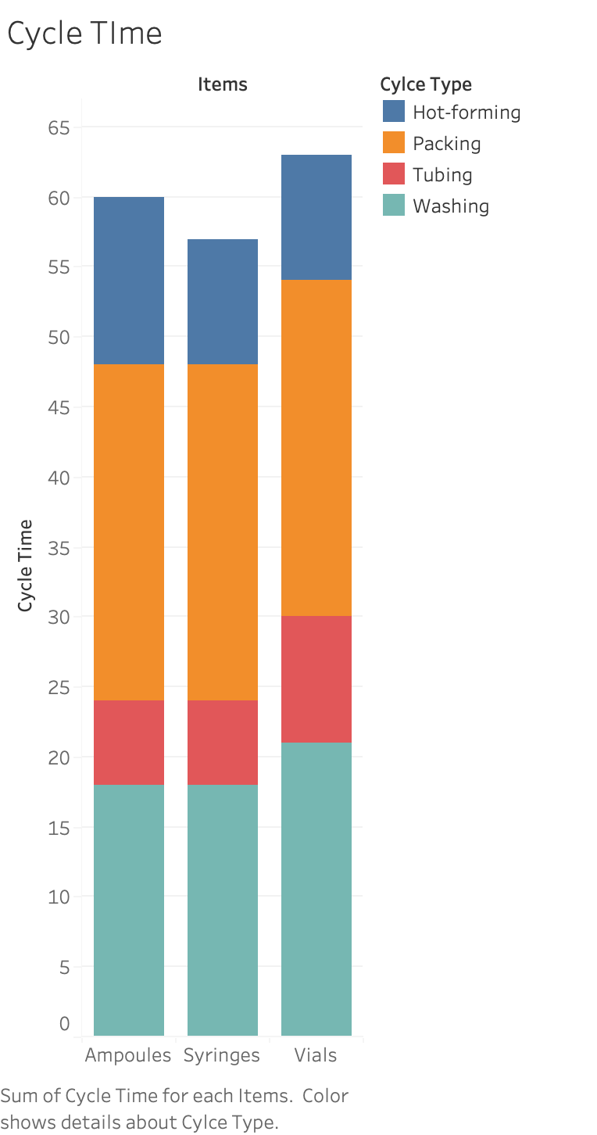

Slide 4
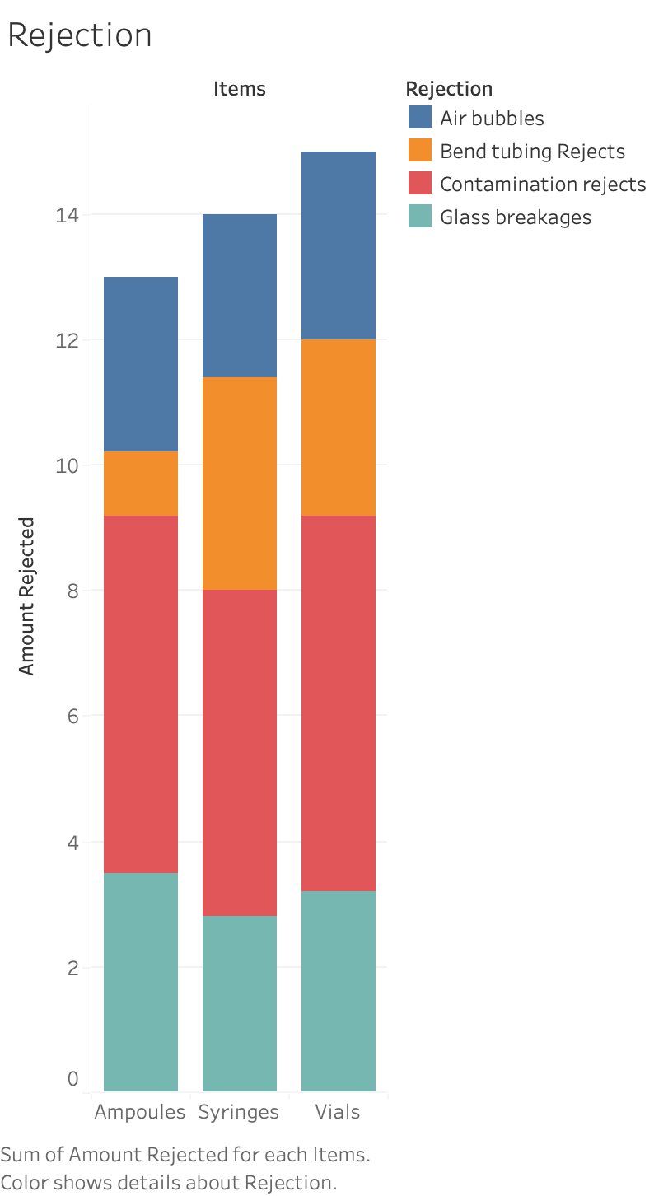

Slide 5
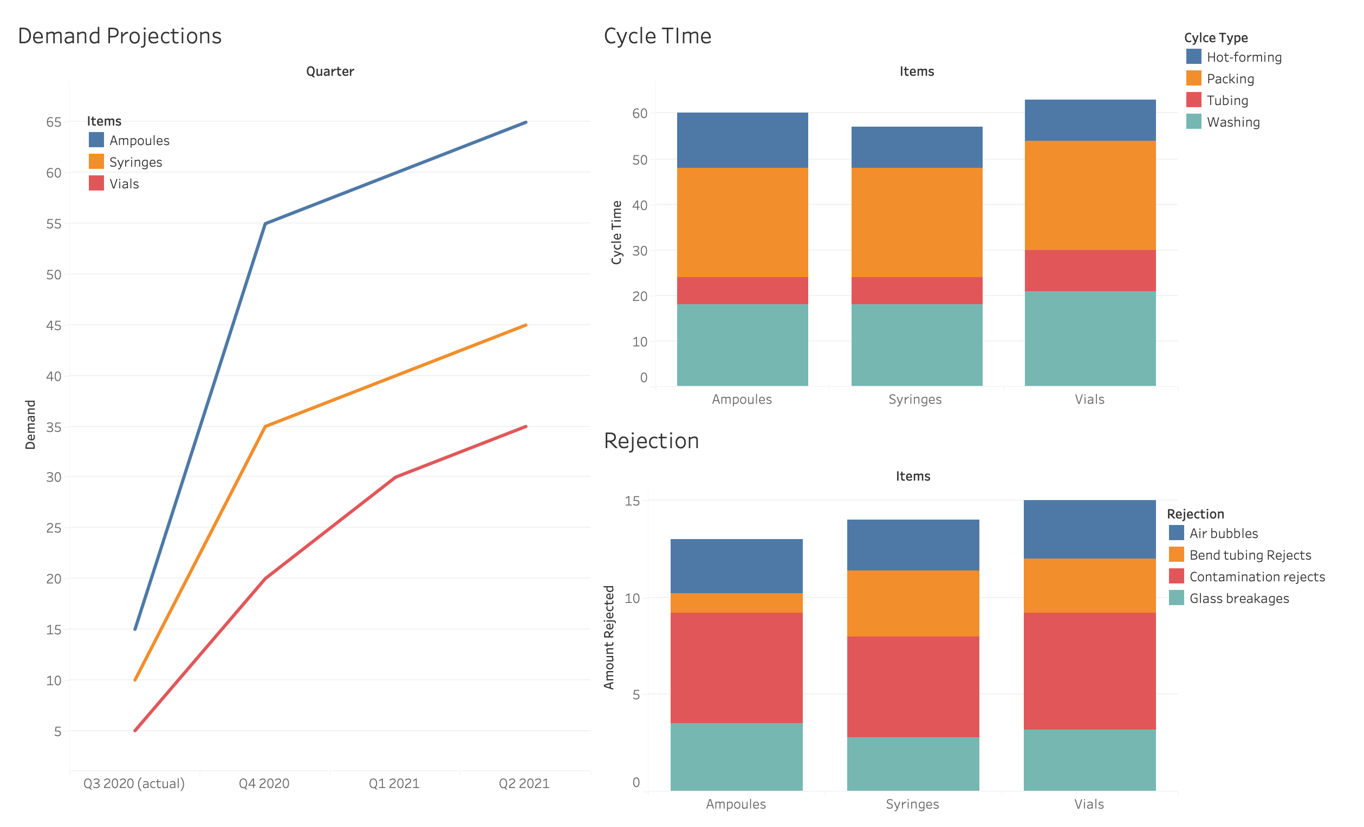

Slide 6
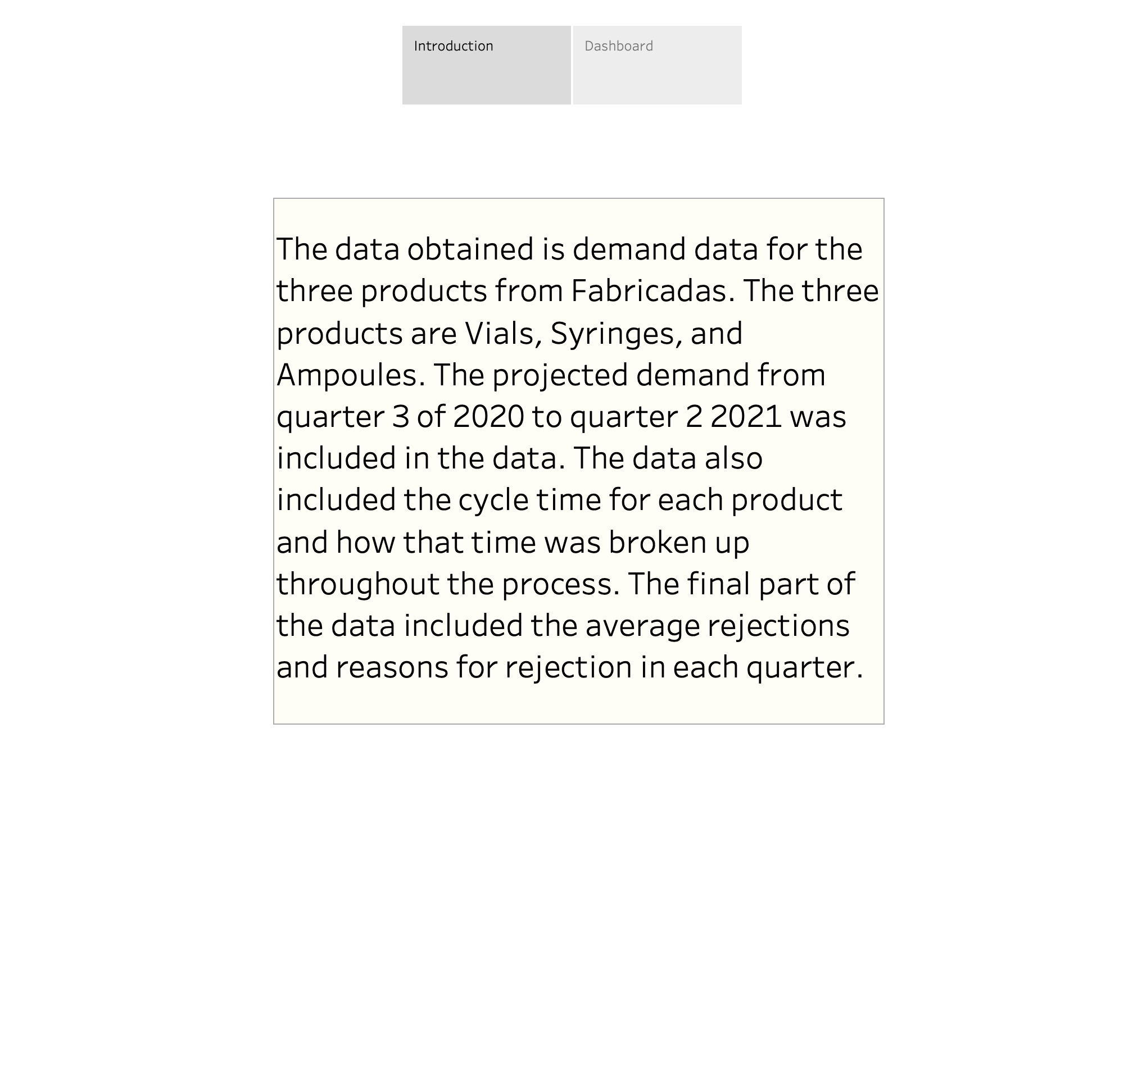

Slide 7
